Slide 1
Reward Shaping Analysis
Finall project
Alexandra Belkind & Daniel Chernov

Slide 2
FrozenLake
FrozenLake is a classic discrete grid-world environment from the Gymnasium library.
Objective: The agent must navigate from the Start (S) point to the Goal (G) on a frozen surface.
Challenge: The agent must avoid falling into Holes (H).
Dynamics: The surface is described as "slippery" (stochastic), meaning the agent might not always move in the intended direction due to the ice.

Slide 3
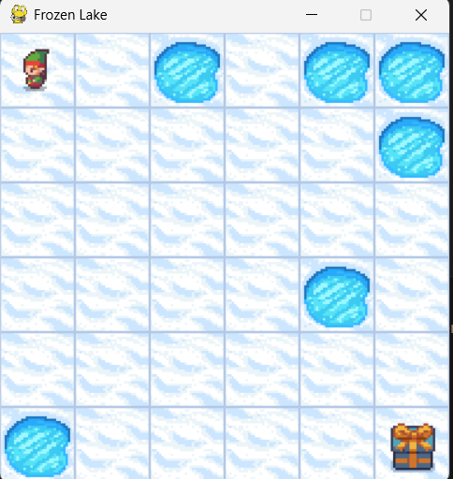
Our Map & Initial Reward Function
The environment is initialized with a sparse binary reward function:
- Reward = +1: Only granted upon reaching the Goal.
- Reward = 0: Given for any other step (walking on Frozen surface or falling into a Hole).
This sparsity makes learning difficult, necessitating the use of Reward Shaping.

Slide 4

SARSA
The Concept (Learn on the Fly):
SARSA updates its knowledge after every single step.
The Name stands for State, Action, Reward, State (next), Action (next) - the exact sequence needed for one update.
The Update Rule:
The agent updates the Q-value using the standard Constant $α$ formula:
$$Q\left(S,A\right)=Q\left(S,A\right)+α\left[R+γQ\left(R^{′},A^{′}\right)−Q\left(s,A\right)\right]$$
On-Policy: This makes SARSA "safe" or realistic. It learns based on what it actually does, not just assuming it will play perfectly.

Slide 5

Monte-Carlo (Every Visit)
The Concept (Learn from History):
Monte Carlo agent waits for the entire episode to finish.
It then looks at the episode in reverse (from end to start) to calculate the total Returns (G) for every decision it made along the way.
The Update Rule:
Instead of calculating a simple average of all past returns (Theoretical approach), we use a Constant $α$ update rule:
$$Q\left(S,A\right)=Q\left(S,A\right)+α\left[G−Q\left(S,A\right)\right]$$
Every-Visit: We update the Q-value every time a state is visited in the episode, not just the first time.

Slide 6
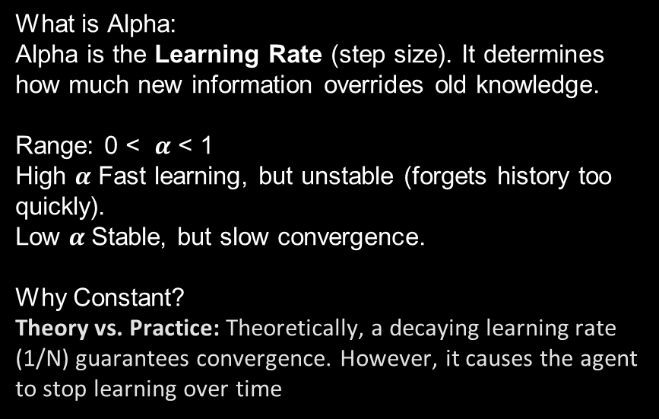
The Learning Rate Strategy-Constant Alpha
What is Alpha:
Alpha is the Learning Rate (step size). It determines how much new information overrides old knowledge.
Range: 0 < $α$ < 1
High $α$ Fast learning, but unstable (forgets history too quickly).
Low $α$Stable, but slow convergence.
Why Constant?
Theory vs. Practice: Theoretically, a decaying learning rate (1/N) guarantees convergence. However, it causes the agent to stop learning over time

Slide 7
Standard Shaping Methods
Baseline: Uses the original sparse reward (+1 only at Goal, 0 otherwise). Used as a control group.
Step Cost: Adds a constant penalty (-0.01) per step. This encourages the agent to find the shortest path to the goal to minimize accumulated debt.
Potential-Based Shaping (PBRS):
Based on the theoretical framework by Ng et al. (1999).
Heuristic : We used the negative Manhattan Distance to the goal. As the agent gets closer, the reward is positive; if it moves away, it is negative.

Slide 8
Custom 1 - Safety First
Motivation:
In the standard FrozenLake, falling into a hole yields a reward of 0. To the agent, this is technically "not bad" compared to wandering aimlessly.
We wanted to explicitly teach the agent that dying is bad.
Implementation:
We utilized our Wrapper to combine the logic from the previous strategies.
The Key Addition: We added a specific condition for failure. If the agent falls into a hole, we apply a specific Penalty of -0.5.
Advantages:
This strategy solves the conflict between speed and safety. The agent wants to reach the goal fast but is forced to be careful around holes.

Slide 9
Custom 2 - Advanced Guidance
Implementation:
We used our Wrapper to combine all the logic we discussed into one formula.
Potential: To guide the agent toward the goal.
Step Cost (-0.001): To encourage speed.
Hole Penalty (-0.5): If the agent falls, it gets a specific punishment of -0.5.
Formula: Total= Potential + CumulativeStepCost + HolePenalty
Advantages:
This strategy balances efficiency with safety and accelerates learning by turning neutral failures into clear penalties.

Slide 10
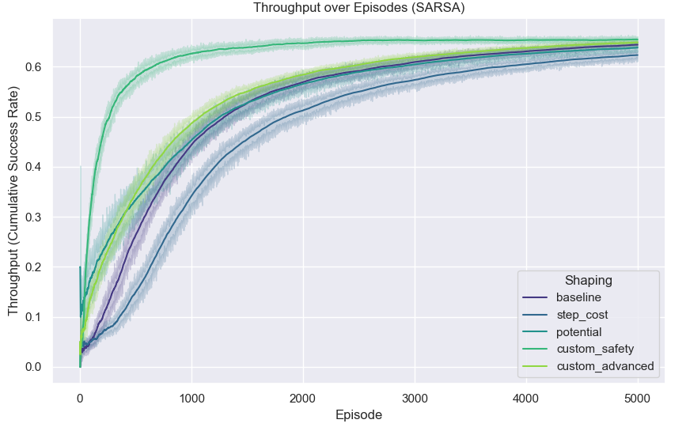
Throughput SARSA
Throughput represents the Cumulative Success Rate, tracking the percentage of successful episodes as training progresses.

Slide 11
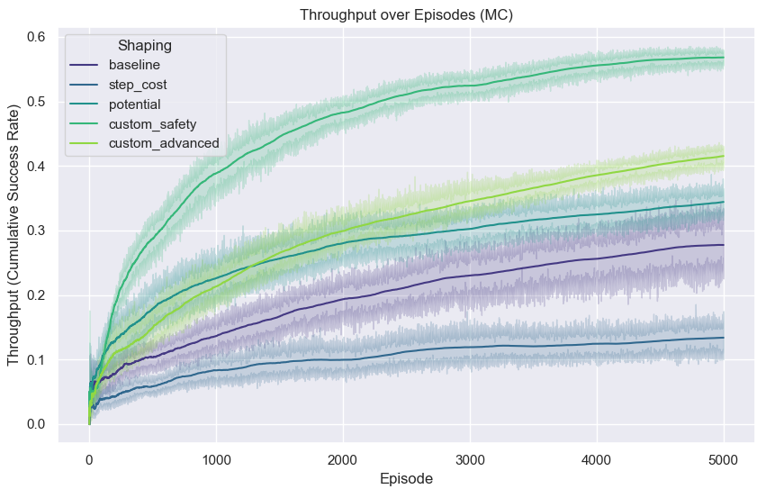
Throughput MC

Slide 12
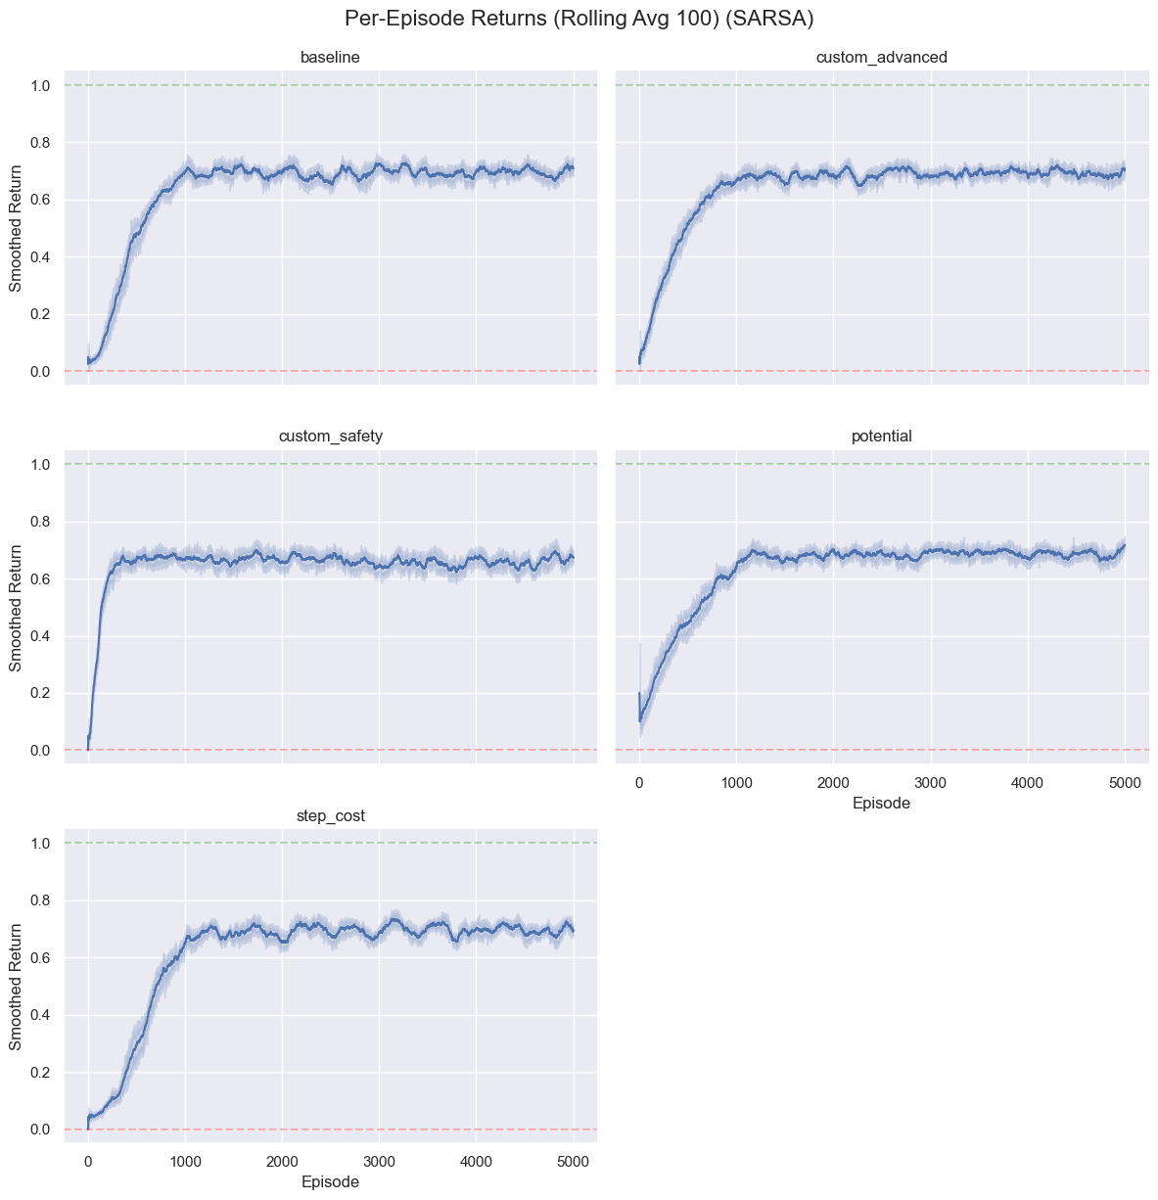
Returns SARSA

Slide 13
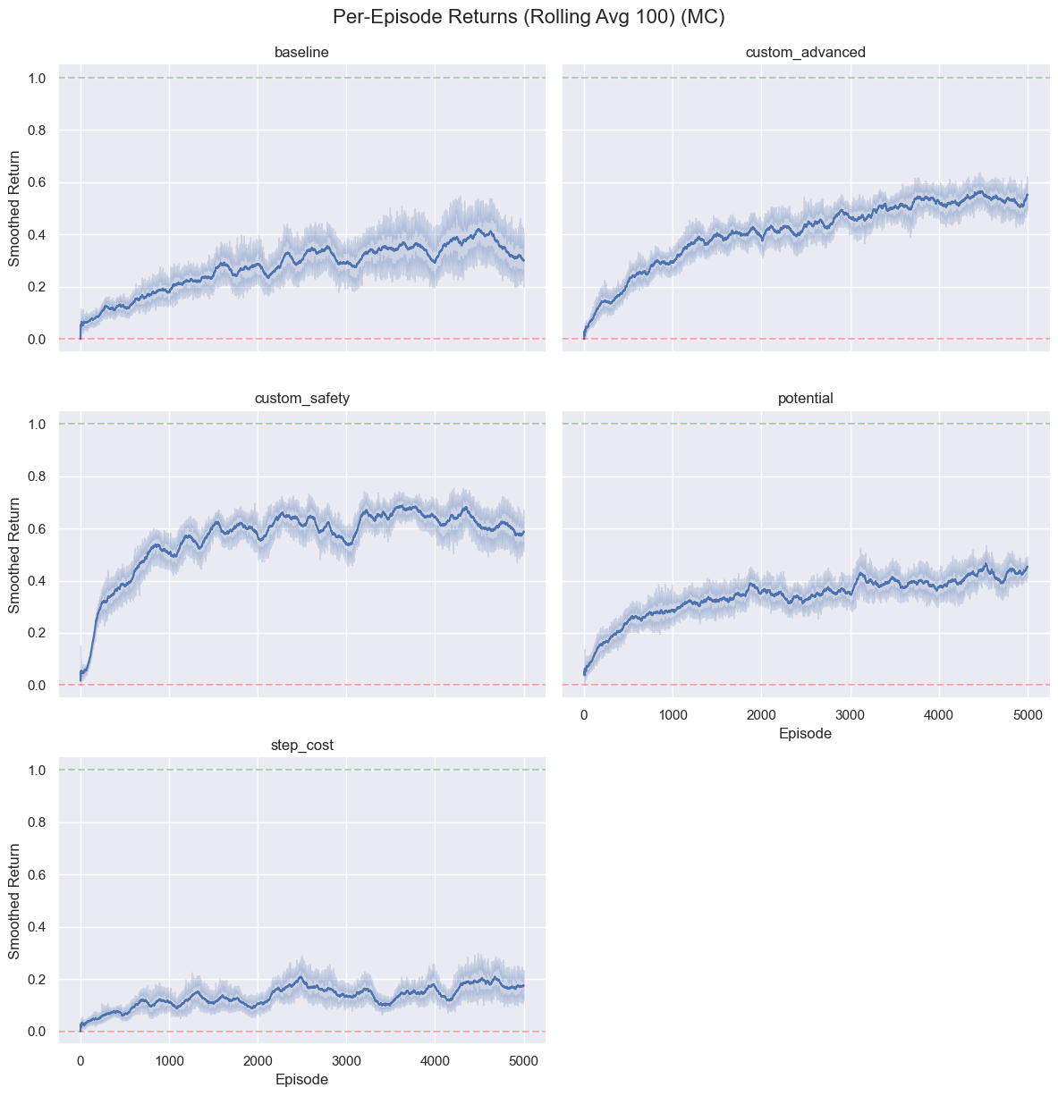
Returns MC

Slide 14
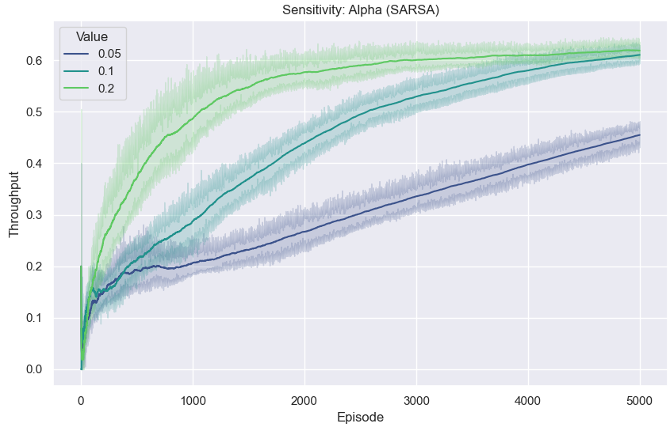
Sensitive SARSA Alpha

Slide 15
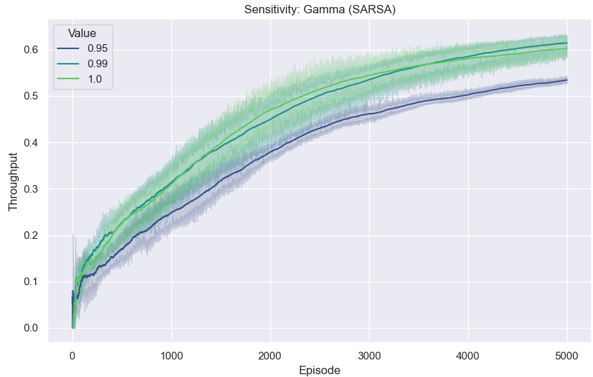
Sensitive SARSA Gamma

Slide 16
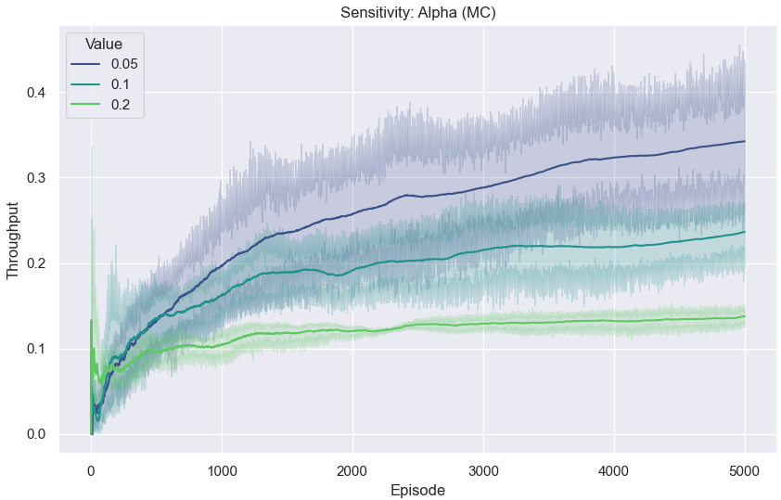
Sensitive MC Alpha

Slide 17
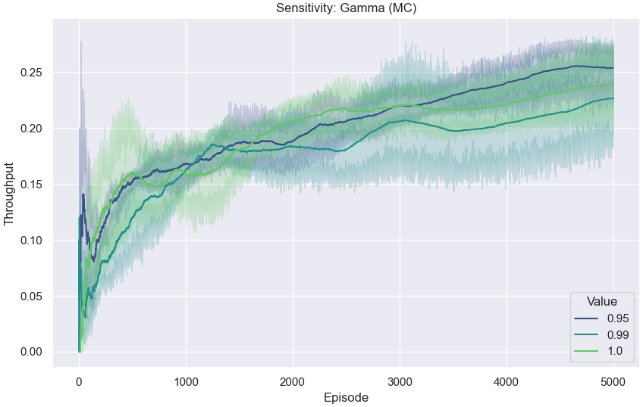
Sensitive MC Gamma

Slide 18
Results

Slide 19
Video

Slide 20
What we learned

Slide 21
Conclusions

Slide 22
Thank you & goodbye

